Slide 1

Subject Name:- Microprocessor & Microcontroller
Subject Code:- KEC-502
Unit No.:- 5
Lecture No.:- 5
Topic Name :-8051 Timer Programming
Er. Preeti Verma
ECE Department

Slide 2
Timers of 8051
8051 microcontrollers have two timers/counters which work on the clock frequency. Timer/counter can be used for time delay generation, counting external events etc.
Both Timer 0 and Timer 1 are 16-bit wide. Since the 8051 follows an 8-bit architecture, each 16 bit is accessed as two separate registers of low-byte and high-byte.
The 16-bit register of Timer 0 is accessed as low- and high-byte. The low-byte register is called TL0 (Timer 0 low byte) and the high-byte register is called TH0 (Timer 0 high byte).
Timer 0 Register
These registers can be accessed like any other register. For example, the instruction MOV TL0, #04H moves the value into the low-byte of Timer 0.

Slide 3
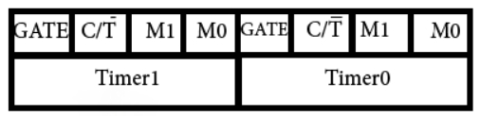
Timer 1 Register
The 16-bit register of Timer 1 is accessed as low- and high-byte. The low-byte register is called TL1 (Timer 1 low byte) and the high-byte register is called TH1 (Timer 1 high byte). These registers can be accessed like any other register. For example, the instruction MOV TL1, #4H moves the value into the low-byte of Timer 1.
TMOD (Timer Mode) Register
Both Timer 0 and Timer 1 use the same register to set the various timer operation modes. It is an 8-bit register in which the lower 4 bits are set aside for Timer 0 and the upper four bits for Timers1. In each case, the lower 2 bits are used to set the timer mode in advance and the upper 2 bits are used to specify the location.

Slide 4
GATE
Every timer has a means of starting and stopping. Some timers do this by software, some by hardware, and some have both software and hardware controls. 8051 timers have both software and hardware controls.
The start and stop of a timer is controlled by software using the instruction SETB TR1 and CLR TR1 for timer 1, and SETB TR0 and CLR TR0 for timer 0.
The SETB instruction is used to start it and it is stopped by the CLR instruction.
These instructions start and stop the timers as long as GATE = 0 in the TMOD register. Timers can be started and stopped by an external source by making GATE = 1 in the TMOD register.

Slide 5
C/T (CLOCK / TIMER)
This bit in the TMOD register is used to decide whether a timer is used as a delay generator or an event manager.
If C/T = 0, it is used as a timer for timer delay generation. The clock source to create the time delay is the crystal frequency of the 8051. If C/T = 0, the crystal frequency attached to the 8051 also decides the speed at which the 8051 timer ticks at a regular interval.
Timer frequency is always 1/12th of the frequency of the crystal attached to the 8051. Although various 8051 based systems have an XTAL frequency of 10 MHz to 40 MHz, we normally work with the XTAL frequency of 11.0592 MHz.
It is because the baud rate for serial communication of the 8051.XTAL = 11.0592 allows the 8051 system to communicate with the PC with no errors.

Slide 6
M1 / M2
M1 | M2 | Mode
0 | 0 | 13-bit timer mode.
0 | 1 | 16-bit timer mode.
1 | 0 | 8-bit auto reload mode.
1 | 1 | Spilt mode.

Slide 7
TCON Register
TCON is 8-bit control register and contains timer and interrupt flags.
Bit 7 - TF1: Timer1 Overflow Flag
1 = Timer1 overflow occurred (i.e. Timer1 goes to its max and roll over back to zero).
0 = Timer1 overflow not occurred.
It is cleared through software. In Timer1 overflow interrupt service routine, this bit will get cleared automatically while exiting from ISR.
Bit 6 - TR1: Timer1 Run Control Bit
1 = Timer1 start.
0 = Timer1 stop.
It is set and cleared by software

Slide 8
Bit 5 – TF0: Timer0 Overflow Flag
1 = Timer0 overflow occurred (i.e. Timer0 goes to its max and roll over back to zero).
0 = Timer0 overflow not occurred.
It is cleared through software. In Timer0 overflow interrupt service routine, this bit will get cleared automatically while exiting from ISR.
Bit 4 – TR0: Timer0 Run Control Bit
1 = Timer0 start.
0 = Timer0 stop.
It is set and cleared by software.
Bit 3 - IE1: External Interrupt1 Edge Flag
1 = External interrupt1 occurred.
0 = External interrupt1 Processed.
It is set and cleared by hardware.

Slide 9
Bit 2 - IT1: External Interrupt1 Trigger Type Select Bit
1 = Interrupt occur on falling edge at INT1 pin.
0 = Interrupt occur on low level at INT1 pin.
Bit 1 – IE0: External Interrupt0 Edge Flag
1 = External interrupt0 occurred.
0 = External interrupt0 Processed.
It is set and cleared by hardware.
Bit 0 – IT0: External Interrupt0 Trigger Type Select Bit
1 = Interrupt occur on falling edge at INT0 pin.
0 = Interrupt occur on low level at INT0 pin.

Slide 10
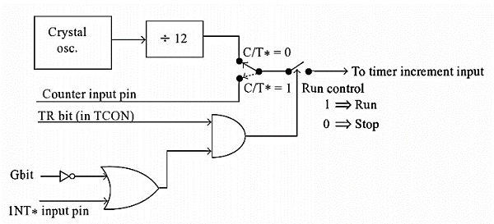
The circuit that controls the running of the timers.

Slide 11
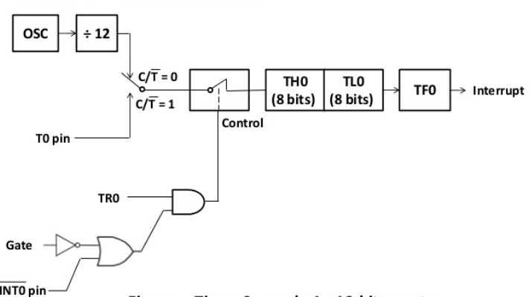
Mode 1 of Timer/Counter
The Mode 1 operation is the 16-bit timer or counter. In the following diagram, we are using Mode 1 for Timer0.
In this case every event for counter operations or machine cycles for timer operation, the TH0– TL0 register-pair will be incremented by 1.
When the register pair overflows from FFFFH to 0000H, then the TF0 of TCON register will be high, and it stops the timer/counter.
So for an example, we can say that if the TH0 – TL0 register pair is holding FFF0H, and it is in timer mode.
Then TF0 will be high after 10H = 16 machine cycles.

Slide 12
Programming steps for delay function
Load TMOD register value i.e. TMOD = 0x01 for Timer0 mode1 (16-bit timer mode).
Load calculated THx value i.e. here TH0 = 0xFC.
Load calculated TLx value i.e. here TL0 = 0x74.
Start timer by setting TRx bit. i.e. here TR0 = 1.
Poll TFx flag till it does not get set.
Stop timer by clearing TRx bit. i.e. here TR0 = 0.
Clear timer flag TFx bit i.e. here TF0 = 0.
Repeat from step 1 to 7 for delay again.

Slide 13
Ex- Timer 1 of 8051 to generate 1 KHz square wave on P2.1 using mode 1. Assume crystal frequency to 12 MHz
Calculation:
Square wave frequency = 1KHz
1 pulse = 1/1KHz = 1 ms
500 μsec ON time and 500 μsec OFF line.
Crystal Frequency = 12MHz
1 clock pulse = 1μsec.
Count = 500μsec/1μsec = 500
Counter initial value = 65536 - 500 = 65036 = FE0C
Program:
Back: MOV TMOD, #01H
MOV TL0 , #0CH
MOV TH0, #0FEH
SETB TR0
Again: JNB TF0 Again
CLR TR0
CPL P2.1
CLR TF1
SJMP Back

Slide 14
Important Questions
What is the advantages of serial communication over parallel communication.
With XTAL = 11.0592 MHz, find the TH1 value needed to have the following baud rates.
a) 9600 b) 2400
What is the difference between the operation of a timer and a counter?
Which is the function of the TMOD register?
Write a program to create a delay of 1ms with XTAL=22 MHz?

Slide 15
References
Text Books:
Mazidi Ali Muhammad, Mazidi Gillispie Janice, and McKinlay Rolin D., “The 8051 Microcontroller and Embedded Systems using Assembly and C”, Pearson, 2nd Edition,2006
Shah Satish, “8051 Microcontrollers MCS 51 Family and its variants”, Oxford,2010
Reference Books:
1. V. Udayashankara, M.S. Mallikajunaswamy, “8051 Microcontroller Hardware, Software and Applications”, McGraw-Hill, 2017

Slide 16
Thank You

